Slide 1
NIHR Best Practice Working Group on Living Evidence Synthesis | Bi-Monthly Meeting | 7th July 2026
Survey of Current Practice in Living Evidence Synthesis #1: Launch
Ian Shemilt & Anna Noel-Storr

Slide 2

Notes:
Minus the Q&A

Slide 3
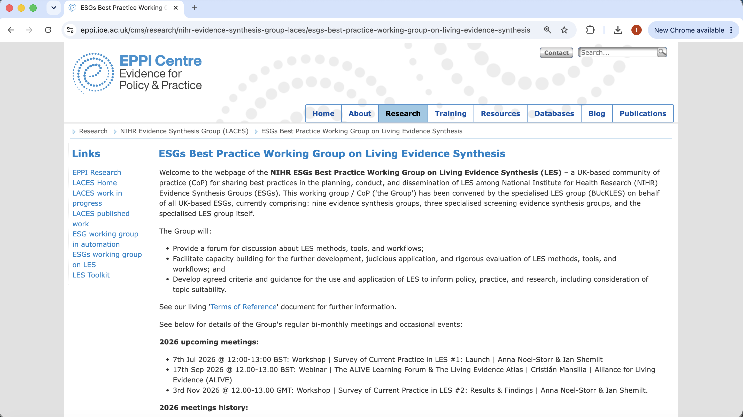
https://eppi.ioe.ac.uk/cms/Default.aspx?tabid=3964

Slide 4
Best Practice Working Group on Living Evidence Synthesis
Aims
To provide a forum for discussion about LES methods, tools, and workflows
To facilitate capacity building for the further development, judicious application, and rigorous evaluation of LES methods, tools, and workflows
To develop agreed criteria and guidance for the use and application of LES to inform policy, practice, and research, including consideration of topic suitability

Slide 5
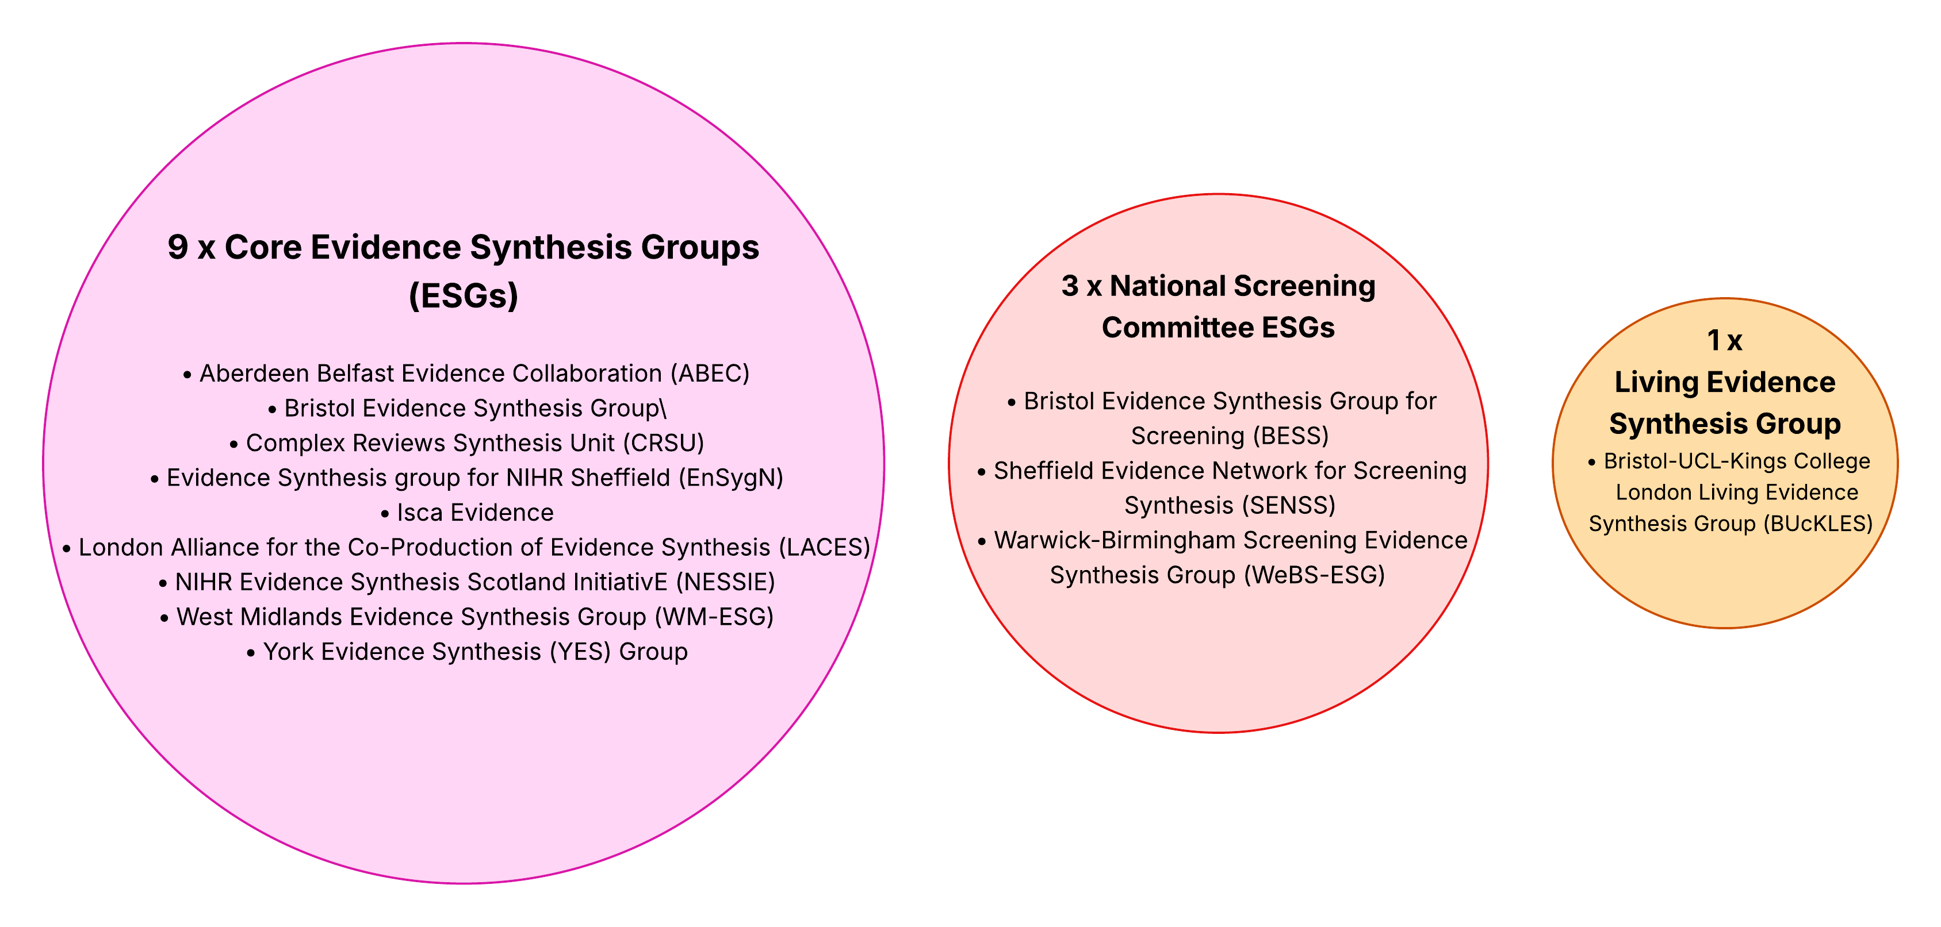
UK NIHR Evidence Synthesis Groups
https://www.nihr.ac.uk/funding-programmes/evidence-synthesis/what-we-have-funded

Slide 6
Survey of Current Practice in Living Evidence Synthesis among NIHR Evidence Synthesis Groups (1)
Aims
To collect baseline data about the characteristics of living evidence syntheses produced by NIHR Evidence Synthesis Groups (ESGs) and our investigators
To enable a shared understanding of current practices used to produce living evidence syntheses among NIHR ESGs and our investigators
To help inform discussion and planning of further activities and outputs of the Best Practice Working Group on Living Evidence Synthesis
To be repeated bi-annually?

Slide 7
Survey of Current Practice in Living Evidence Synthesis among NIHR Evidence Synthesis Groups (2)
We will distribute the survey link this week by e-mail to the designated lead member(s) of the BPWG on LES for each ESG
We will request one coordinated response per ESG, please!
You will need input from people closely involved in decision-making about your ESG’s current or completed LES projects
Time to complete: Highly variable, contingent on LES activity (~2 mins; up to ~2 hours)
Submission deadline: 23:59 on Friday 2nd October 2026
Regular e-mail reminders will be sent!
Notes:
We will invite the nominated lead member(s) of our Best Practice Working Group for each ESG (excluding BucKLES) to coordinate a single response on their ESG's behalf. However, some of the survey questions - specifically those relating to decision-making about the initiation and retirement of living evidence syntheses, and others requiring reflection on experiences of producing them - can only be answered by people who have been closely involved in the planning and production of an ESG's current living evidence syntheses. We therefore plan to suggest to respondents that if they have not themselves been closely involved in the planning and production of all of their ESG's current living evidence syntheses, they should consider convening a group meeting to complete the survey in collaboration with one or more other people in their ESG with the relevant experience.

Slide 8
Survey of Current Practice in Living Evidence Synthesis among NIHR Evidence Synthesis Groups (3)
Delivered through Qualtrics, UCL's under a UCL subscription
A summary report will compile the aggregate results and key findings
ESG responses are anonymised
Responses remain within the BPWG co-leads only
Aggregate findings, alongside anonymised responses, will be discussed at the November bi-monthly meeting
Participation is optional

Slide 9
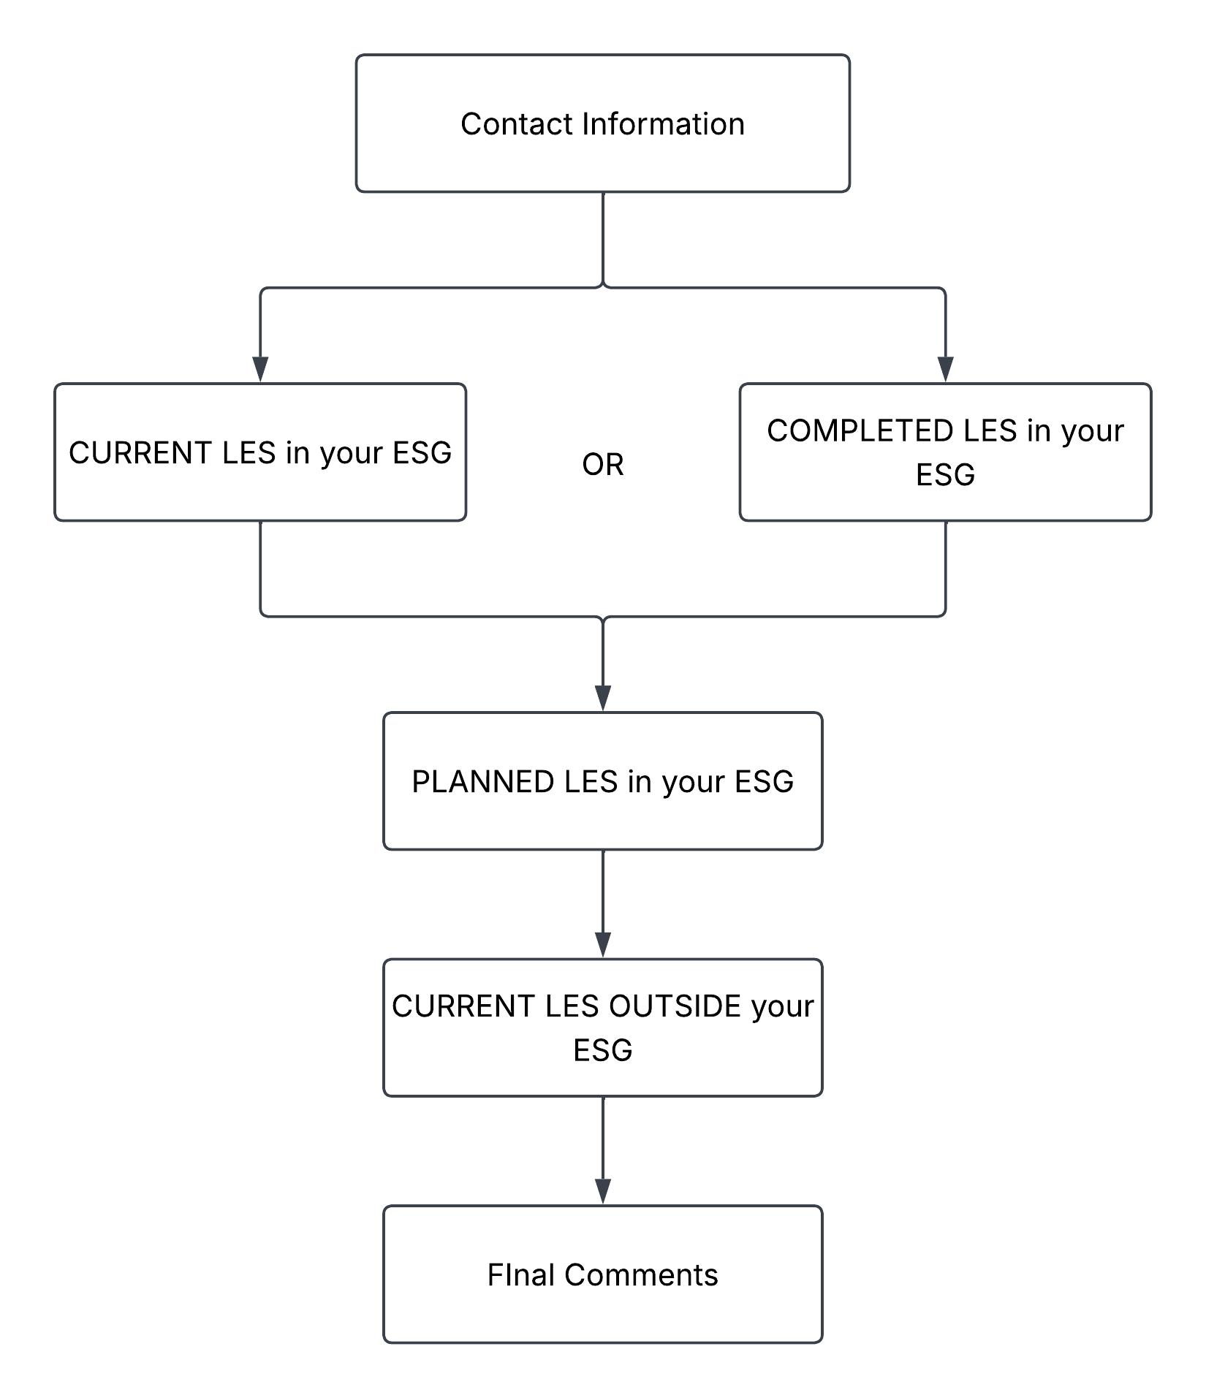
Survey of Current Practice in Living Evidence Synthesis among NIHR Evidence Synthesis Groups (4)

Slide 10
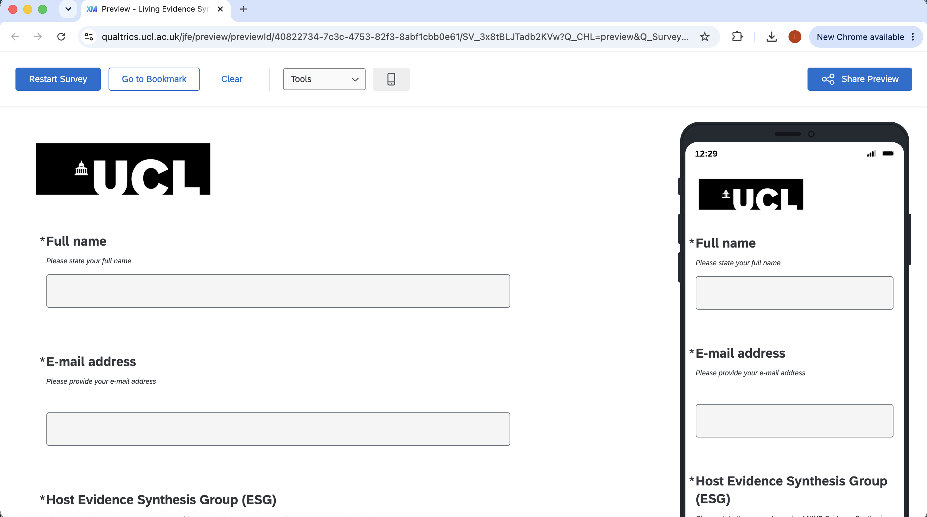

Slide 11
NIHR Best Practice Working Group on Living Evidence Synthesis | Bi-Monthly Meeting | 7th July 2026
Survey of Current Practice in Living Evidence Synthesis #1: Launch
Ian Shemilt & Anna Noel-Storr

Slide 12
https://eppi.ioe.ac.uk/cms/Default.aspx?tabid=3964

